Slide 1


Team Members
Hardik | Dhaz | Chetna | Axle | Jordan
1

Slide 2
CONTENT OVERVIEW
1
2
3
PROBLEM STATEMENT
STORY
RESEARCH
4
5
6
PROPOSAL
FINANCIALS
RISKS

Slide 3
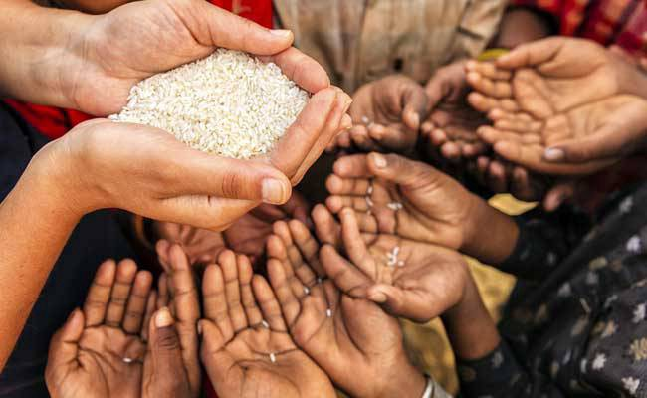
Story
of
Wastage & Hunger

Slide 4








RESEARCH
Research
554M
People have Ration Card
135M people suffer
from acute hunger created due to
Man-made conflicts & Economic downturn
102/117
Rank as per GHI-19
(Source: World Food Program)
~92,651 Cr. Rs.
Post harvest loss per year due to poor storage and supply chain.
(Crop Loss Report: APSA 2018)
190M People are
Undernourished as per GHI-19
>5.6M Children (0-4 YO)
are in severe wasting Category
>840M
People affected by hunger by 2030
0.6M Deaths
were due to Malnutrition in 2018

Slide 5
RESEARCH
Ground Work [Survey with Ration Distributor]
To understand the scene on ground level, 1 member of our team met with 2 Ration shop sellers.
Question Asked | Ration Shop 1 | Ration Shop 2
How many families comes under your ward? | 115 | 145
How much food grains are distributes [legally] per family member? | 5 kg/person [Rice or Wheat] | 5 kg/person [Rice or Wheat]
How do you know if the family is from your ward? | Ration Card & our data Register | Ration Card & our data Register
What type of Ration cards are there? | BPL – Yellow [Below poverty line] APL – White [Earning <1 lacs.] AAY – Red [Poorest of the poor] | BPL – Yellow [Below poverty line] APL – White [Earning <1 lacs.] AAY – Red [Poorest of the poor]
What is the distribution frequency? | 1 time/week | 1 time/week
How often you get the supplies? | 1 time/month | 1 time/month
On what basis did the storage house sends the ration? | Number families in a ward and our indication. | Number families in a ward and our indication.
What is the wastage on monthly basis? | 7-10% [casually replied] | 5-7%

Slide 6
PROBLEM
Problem Statement
Improving the inefficient supply chain of grain distribution that currently leads to the wastage of millions of tonnes on one end, and deaths of lakhs of people due to hunger on the other.
Reasons being,
Unorganized sector
Fragmented supply chain
Vague predictions for monthly requirement
Affected Population
AAY
BPL
APL
[Antyodaya Anna Yojana]
“Poorest of the poor”
[Below Poverty Line]
[Above Poverty Line]
“Income < 1 Lakh/year”

Slide 7
PROBLEM
Voice of Customer [FCI & Consumers]
Needs
Feature
Predictive Model that can indicate and allocate the supply based on demand, using past data & trends as input.
FCI
Understanding the requirement of each warehouse in a state on monthly basis and plan the supplies based past data
Consumer
Enough grains to ensure atleast 2 meals per day.

Slide 8
PROBLEM
Existing Distribution System
Distribution System
Farmer
FCI buy all the grain from the farmers
They supply it to the state's center where it will be stored
These centers then supply it to the ration shops divided on the basis of blocks
Then these ration shops provide those grains to the end consumer
The main priority of government is AAY & BPL and then APL
Center (FCI)
Procurement at MSP
State Govt.
Allocation at CIP
Fair Price Shops
Distribution
Sale of grains at CIP
Beneficiary
SWOT Analysis
Strengths
Weaknesses
Opportunities
Threats
State govt(s) are flexible to make changes in the system as per their requirements
No standardization of data handling & storage at each level and across states.
Organization of storage spaces and improvement in infrastructure.
With increase in population, the after effects [margins of errors will increase exponentially] resulting in proportional wastage/loss of food grains.
Notes:
Strengths –With the learnings of titan (Tanishq specifically) in the retail market clubbed with authenticity of designs sourced from artisans places.)
However, this highly fragmented market spoiling customer will lots of options.

Slide 9
SOLUTION
Our Proposition
Needs captured and delivered by our offering
Feature based on FCI Needs
Indication and allocation of food grains based on past trends
A Predictive model with,
Gives indication for region wise and store wise demand.
Accounts for seasonal consumption based patterns.
Region wise salience of BPL and AAY in getting the grains.
Minimizes over & under allocation of food grains.
Weaknesses, Opportunities & Threats
of existing FCI distribution system
No standardization of data handling & storage at each level and across states.
Organization of storage spaces and improvement in infrastructure.
High margins of error with increase in population.
Notes:
Strengths –With the learnings of titan (Tanishq specifically) in the retail market clubbed with authenticity of designs sourced from artisans places.)
However, this highly fragmented market spoiling customer will lots of options.

Slide 10




SOLUTION
Product “Pravdhan”
ML Driven Web based service connecting the Ration shops with the store manager
Ration Shops
WEB SERVICE
Storage Manager
Algorithm

Slide 11


SOLUTION
Framework [Model Training Mode]
Ration
Machine Learning
Feedback
Data
Data
Predicted Data
Ration Shops
FCI Database
Model
Storage Manager
Training Model to understand the patterns in the data sets.
Constraint Changes
For next month

Slide 12

SOLUTION
Framework [Model Testing Mode]
Feedback Data
Feedback
Data
Data
Predicted Data
Ration Shops
FCI Database
Model
Results Comparison with actual results without deployment
Target – 95% prediction accuracy
Constraint Changes
For next month

Slide 13
SOLUTION
Framework [Model Deployment Mode]
Framework [Model Deployment Mode]
Ration
Feedback
Data
Data
Predicted Data
Ration Shops
FCI Database
Model
Storage Manager
Deployment of Model for all the stores.
Plan in next 5 months: 98-99% accuracy
Constraint Changes
For next month

Slide 14
SOLUTION
Data & Algorithm Details
Assumptions
We have considered only one food item
We haven't considered the leakage loss/natural calamities
Incoming Data from FCI Data set,
Algorithms Used,
EDA(Explanatory Data Analysis)
&
LSTM(Long Short Term Memory)
Date
Block number
Year
Month
Shop ID
Area number
Grains Distributed in a Day
Type of Ration Card [AAY || BPL || APL]
Size of Data-set used,
Training Data 2053484, 9
Testing Data 880065, 9

Slide 15
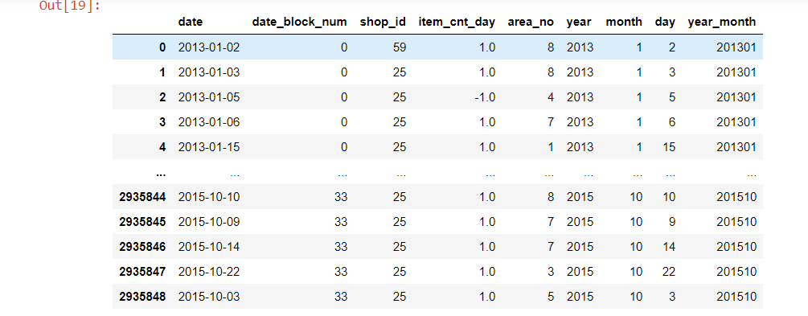
SOLUTION
Data Set

Slide 16
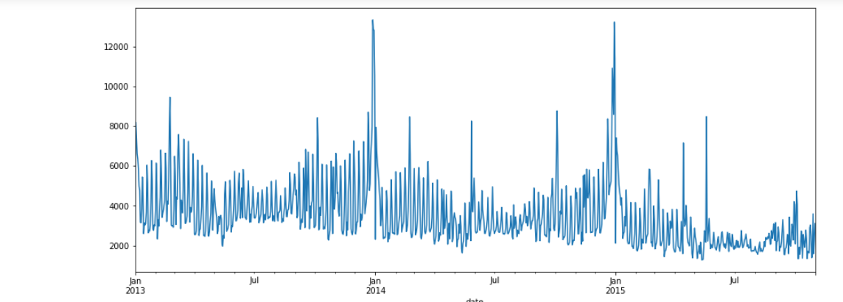
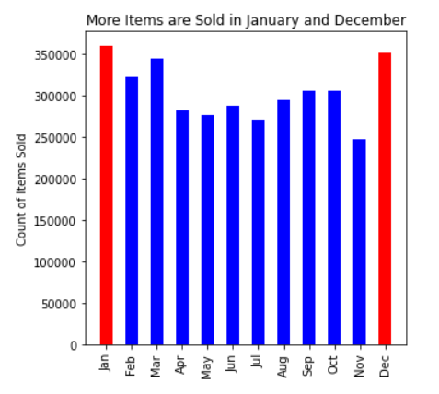
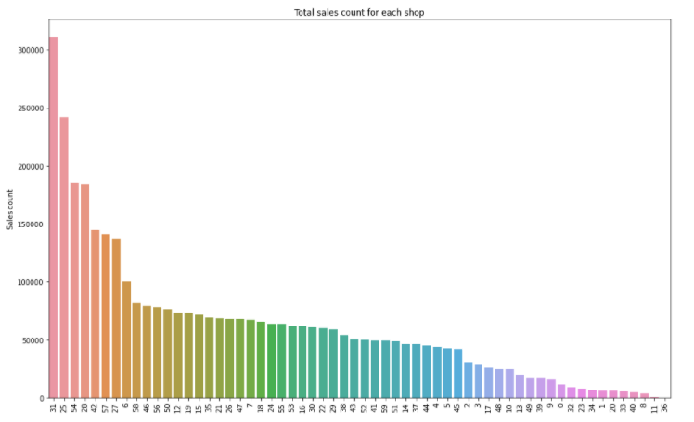
SOLUTION
Model Output
Sale per year
Demand according to month
Demand as per Shop/Area

Slide 17
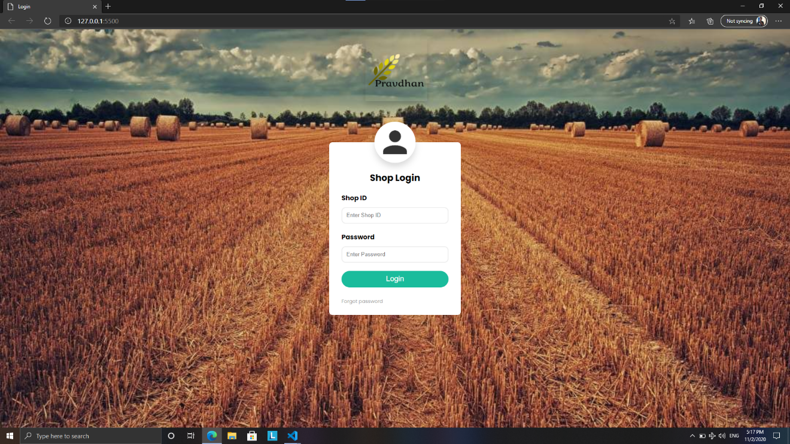
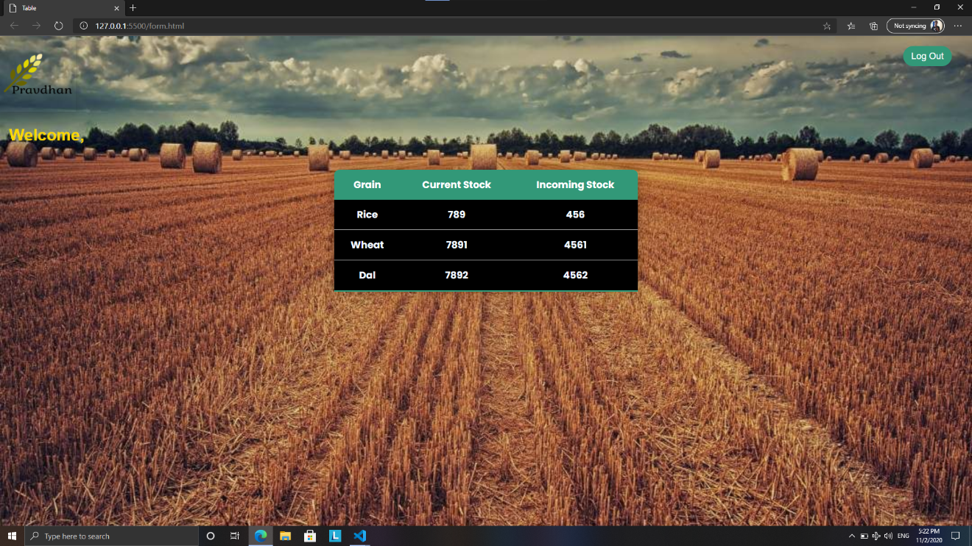
Website [Ration Shop]
Assumption :
Data is updated by the customer every time he swipes the card the entry is exactly reflected in our data
5

Slide 18

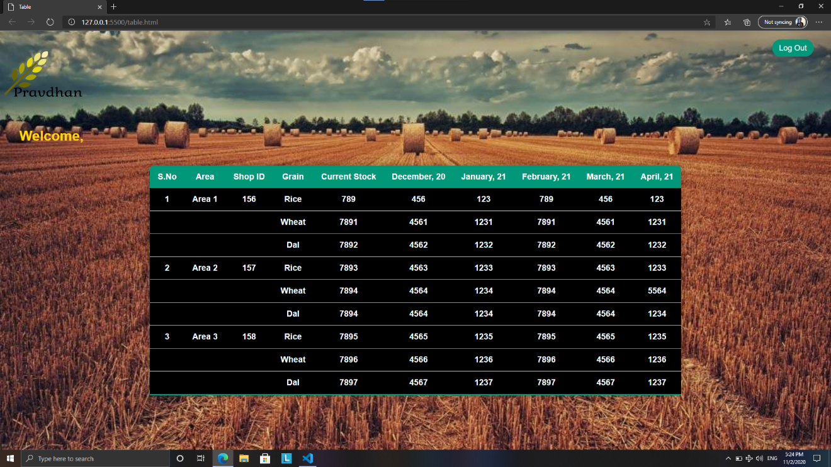
Website [Storage Manager]
5

Slide 19


SOLUTION
The Prototype
Framework [Model Deployment Mode]
Training Data
Predicted Data
Testing Data
Local Database
Input
Model
Local Database
Output
Local Server
Local Host
Constraint Changes
Applied

Slide 20

FINANCIALS

Slide 21
FINANCIALS
Assumptions for Financials
Costs Considered,
Fixed cost: Salary & Office Rent
Operating cost: Server Maintenance, System, Security, Misc., etc.
Data Considered
Food wastage every year – 14B $
Wastage before it reaches customer – 40%
State Considered for Calculation – Jharkhand [Block wise data available at State website]
Top 5 states [Max. number of people dying due to hunger]
Top 5 states [Highest Grain Wastage]
Bihar
Punjab
NE states
Karnataka
Kerala
Jharkhand
Gujarat
Maharashtra
Bihar
Jharkhand
UP
MP
Source: Times of India Study, 2019 “Agricultural wastage is India’s problem No 1 – Here is why

Slide 22
FINANCIALS
Profit Margins
Note: Margins of our services is on the price at which govt. is purchasing from farmers [worst case scenario]
Parameter | Rice | Wheat
Produce (in Mega Tones) | 4,367⁽¹⁾ | 335⁽¹⁾
Wastage (undistributed) | 31.25⁽¹⁾ | 2.4⁽¹⁾
Cost incurred by Govt. (per kg.) | 1.82⁽²⁾ | 1.84⁽²⁾
Cost equivalent of wastage | .81 B$ | .06 B$
Total | 0.87 B$
Loss [due to ineffective supply chain] & Model Accuracy | 34%⁽³⁾ | 34%
Savings | 0.3 B$
Margins (for our service) | 0.1% | 0.1%
Revenue (per year) | 0.0003 B$
Sources:
Data from Jharkhand State Website
Financial Express [Article Dated: Oct-19]
Total Loss – 40% | Our model accuracy – 95%(“±1”)
02.1 Cr. Rs. (per year)

Slide 23
FINANCIALS
Revenue Projections [YoY]
Rs. 60 Cr. (P)
Post proof of concept & implementation,
‘Increase in margins/change in base rate for Revenue Calculations’
Rs. 20 Cr. (P)
Rs.8 Cr
2025
Rs. 4 Cr
2024
Rs. 2.1 Cr
2024
2023
2022
Note: Projections upto 2024 is taken using 14 B$ wastage in FY19.
Consumption increase due to population increase is not considered i.e. CAGR – 1.1%
Source – Statistia

Slide 24







FINANCIALS
Deployment Time plan of Model
Perquisites;
POC readiness
Permissions from FCI
Access to FCI data base and query check
Approaching other states with current portfolio
Data Collection &
Model Training
Data Collection &
Model Training
Deployment of model at all ratio shops in the state
Expand to further 5 states
Start exploring other areas
Achieve 95% accuracy
Monitoring real-time Stats.
Other applicable areas,
Medicines
Blood Banks
Vaccine
Automobiles
FMCG
Deployment at nearest 100 ration shops
>98% accuracy achieved
Nation wide expansion
Jan | Feb | Mar | Apr | May | Jun | Jul | Aug | Sep | Oct | Nov | Dec | 2022 | 2023 | 2024 | 2025
2021

Slide 25
RISKS
Risk Assessment
Natural Calamity
No acceptance from State Govt.
1. Delay in RFID implementation by States.
2. Error of inclusion & exclusion of beneficiaries.
SIGNIFICANT
Data Loss
Server failure
In accuracies in FCI data storage practice.
HIGH
Impact if Occurred
MODERATE
High lead time for Model implementation
Margin of error in Prediction
No accounting for corruption
LOW
MODERATE
Likelihood of Occurrence
LOW

Slide 26
RISKS
Mitigation Plan for Risks Identified
Identified Risk | Category | Risk level | Mitigation Plan
Delay in RFID implementation by States. | FCI |  | We will build the system for their data collection required for our model.
Error of inclusion & exclusion of beneficiaries. | FCI/ Pravdhan |  | Regular monitoring of ration disbursement to each category i.e. Yellow, Blue & Green.
Inaccuracies in FCI data storage practice. | FCI |  | Enhancement/standardization of data collection process as per our model requirement.
No acceptance from State Govt. | Pravdhan |  | We will pitch the idea to the worse hit state and offer to provide service for free. And no deployment until we achieve 98% predictive accuracy
No accounting for corruption | FCI |  | Try to predict outliers and gaps in allocation vs distribution. Suggest enquiry & reasoning for the same.
Natural Calamity | Pravdhan |  | Maintenance of buffer stock at state level. Take help from weather department for indications.
Server failure | Pravdhan |  | Regular server maintenance plans [monthly basis]
Margin of error in Prediction | Pravdhan |  | No deployment before 95% accuracy. Buffer stock.
Data Loss | Pravdhan |  | Data mirroring & deployment of distributed server.
1

Slide 27
A plea to EVERYONE who is Watching this live.
This PROBLEM that we have presented & worked upon
Is way ABOVE this COMPETITION.
FOOD WASTAGE from the LEFTOVERS in our plates have a HUGE contribution.
So,
We REQUEST you to only take as much as you can CONSUME
Remember, 7000 people are DYING EVERYDAY in our country due to hunger, every time you choose to waste.
1

